Slide 1
PNWD SPY ’22-’23 Recap
08/12/23

Slide 2
What does the future of your Volunteer Patrol look like?
Are your long-time patrollers retiring?
Do you lay awake at night since resort management keeps asking if you have a sufficient 5 year patrol pipeline?

Slide 3
2022-23 Recap
Division Goals Update
SPY Programs: Day/Month/Season
SPY Plug & Play Resources

Slide 4
SPY Division Goals
Divisional Leaders/Resources Update
Conference
Meet & Greet
Monthly Call (Div/Natl)
Documentation Revamp

Slide 5
SPY Division Goals
2. Appoint Regional Advisors
Wy’East (5)
Inland (8)
NW (8)
Oregon (4)
S.Idaho (7)
Notes:
Bi-Monthly Calls at 4 Advisors

Slide 6
SPY Division Goals
2. Appoint Regional Advisors
Wy’East
Program @ all 5 areas
Trk 1 (pass ski, empty sled, 3 shadows)
Trk 2 (aid room, 5 shadow days)
Year 2 OEC.
11 SPYs, 4
Notes:
Bi-Monthly Calls at 4 Advisors

Slide 7
MHSP SPY 22-23
New Recruiting Focus
Eastside Ski Team Partnership
Parent/student meetings
Ski Team Ski Swap
CPR/AED Training
Outdoor First Care Training
Shadow Days
On Hill Training
Late Jan to April
Ski Skills
Avalanche Beacon Searches
Empty Sled
Notes:
Bi-Monthly Calls at 4 Advisors

Slide 8
MHSP – SPY Program
Program Successes
10% of OEC class former SPYs
Improved Youth Protection training
Documentation migrated to shared drive
New recruiting pipeline
Notes:
Bi-Monthly Calls at 4 Advisors

Slide 9
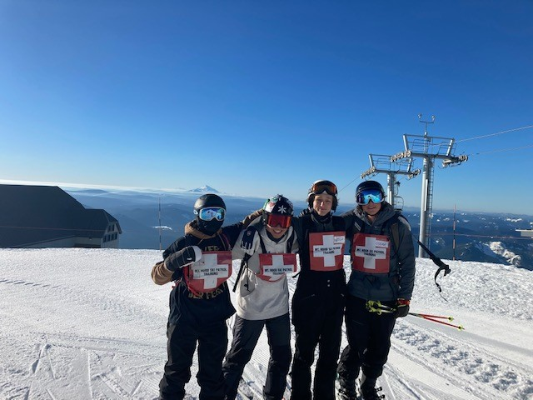
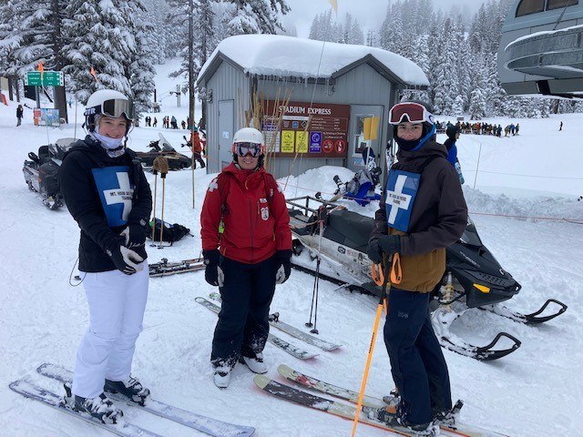
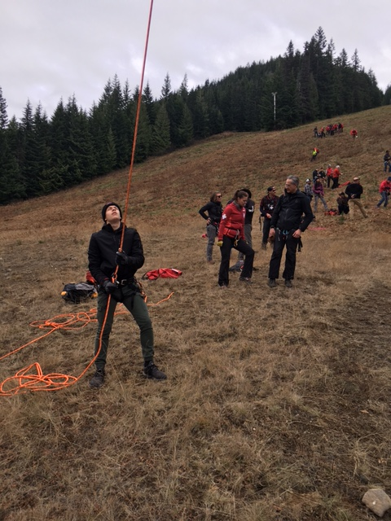
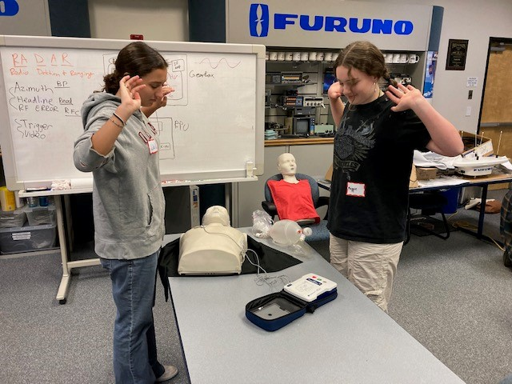
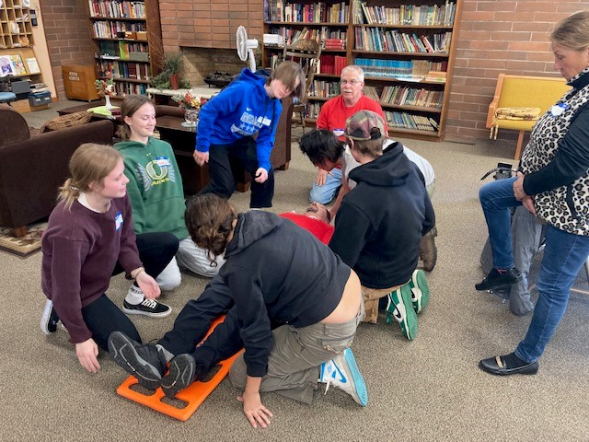
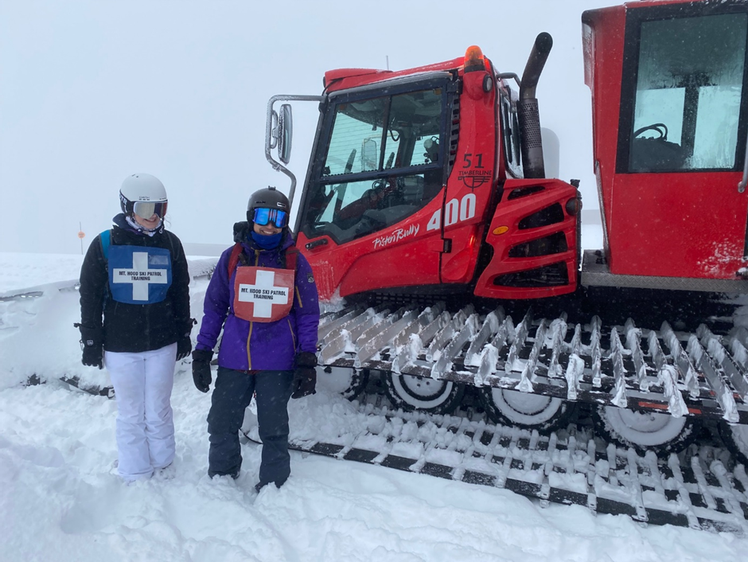

Slide 10
SPY Division Goals
2. Appoint Regional Advisors
Inland
49 Degrees – 1st Year SPY program
2 SPYs
Training Included:
Mtn Ops, Groomers, Life Flight
1st Aid. Empty sleds, OEC overview
6 SPYs next year!
Mt Spokane: 1 SPY
Loup Loup: Youth OEC class
Notes:
Bi-Monthly Calls at 4 Advisors

Slide 11
SPY Division Goals
2. Appoint Regional Advisors
NW (8)
Crystal
4 weeks
40 Interested/20 tested/13 SPY’s
2 OEC
1 Adult Patroller
Notes:
Bi-Monthly Calls at 4 Advisors

Slide 12
Career Series | (Patrol Director) (Volunteer Patrol Director) (Crystal President) (First Aid and CPR) (Crystal Mountain Marketing) (Sports Medicine)
Mountain Ops | Snow Surfaces – Connor Lyons Cat Crew Lift Operations - Kennedie Wagner
Skills & Drills | Short, medium, and long turns Upper/lower body separation Pole planting Off Piste skiing
Signs & Sweeps | Mountain orientation
Avi School | Weather prediction Mitigation work How to read terrain Beacon, probe and rescue shoveling NWAC Reports
Medical Heli Demo | - Mock scenario
SPY Division Goals
SPY 1 Learning Objectives

Slide 13
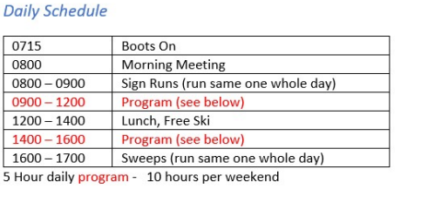
4 Week Program: Each Saturday & Sunday
SPY Team Size: 13 members
SPY Leadership: 2 co-leads
Volunteers:
Avalanche School
Drop in speaker series
Patrol shadowing
Skills & Drills
Social Media
SPY 1 Format
@SkiPatrolYouth_Crystal

Slide 14
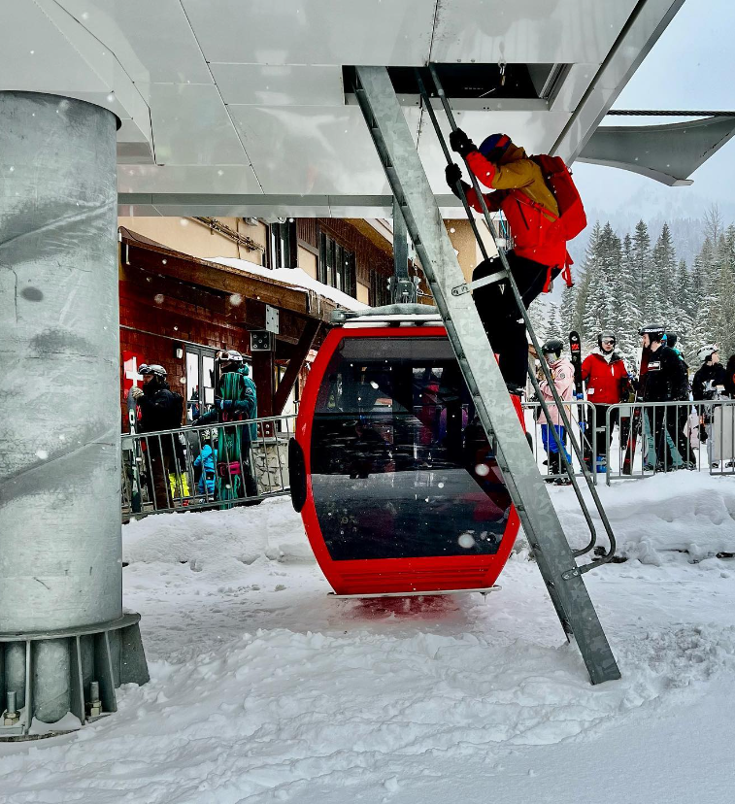
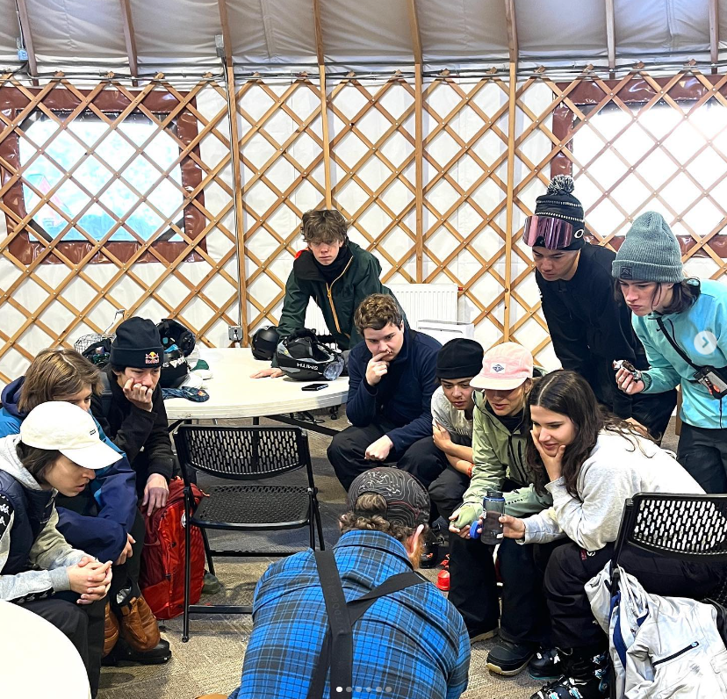
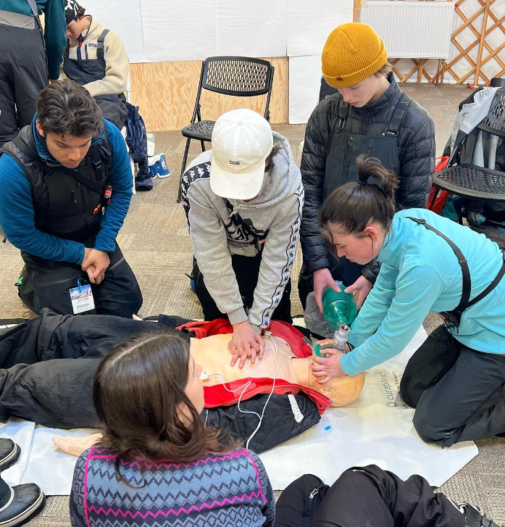
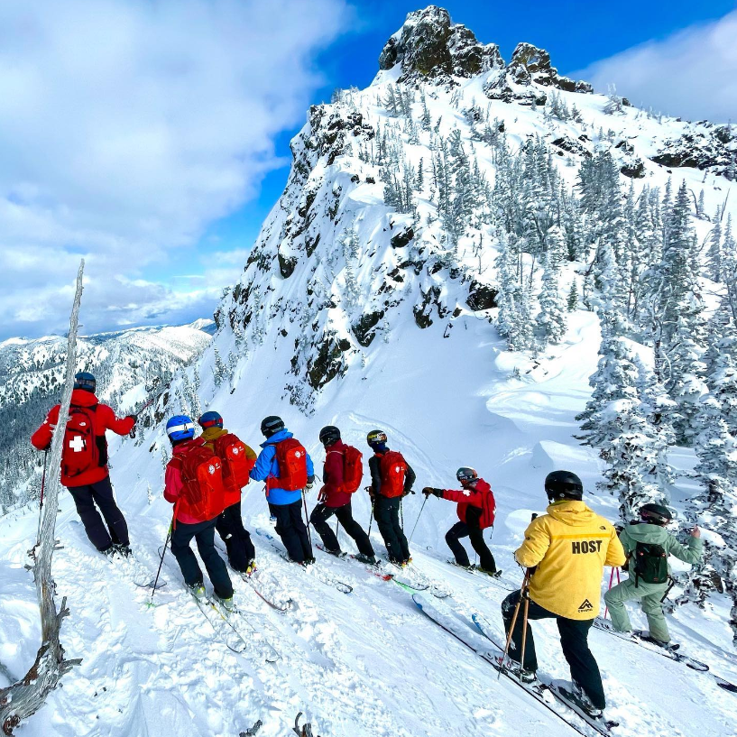
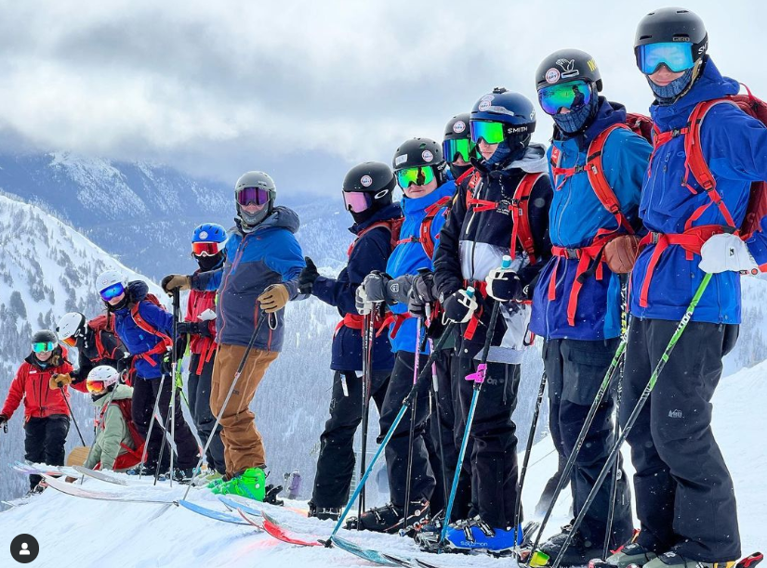
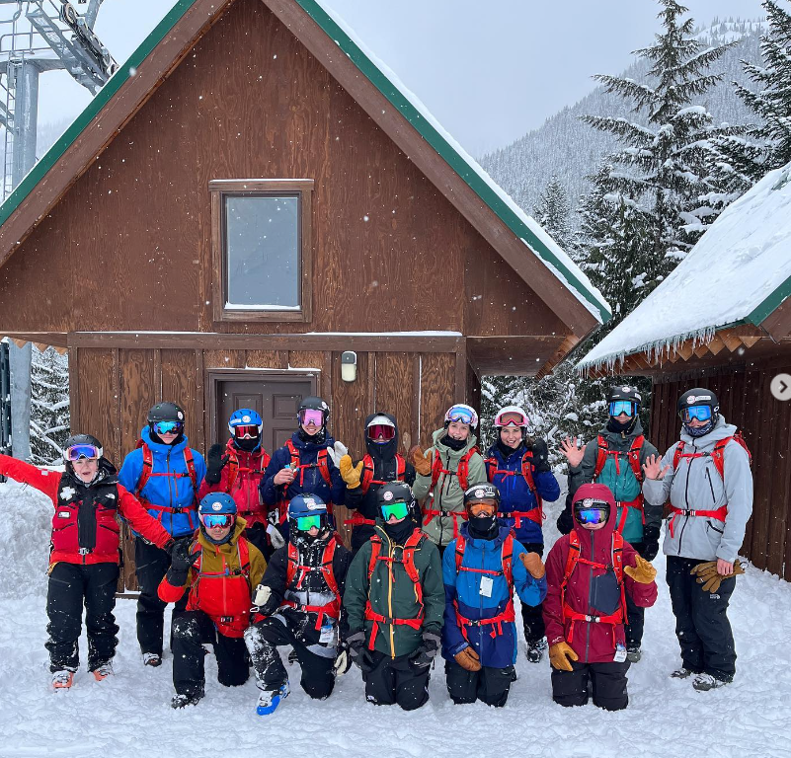
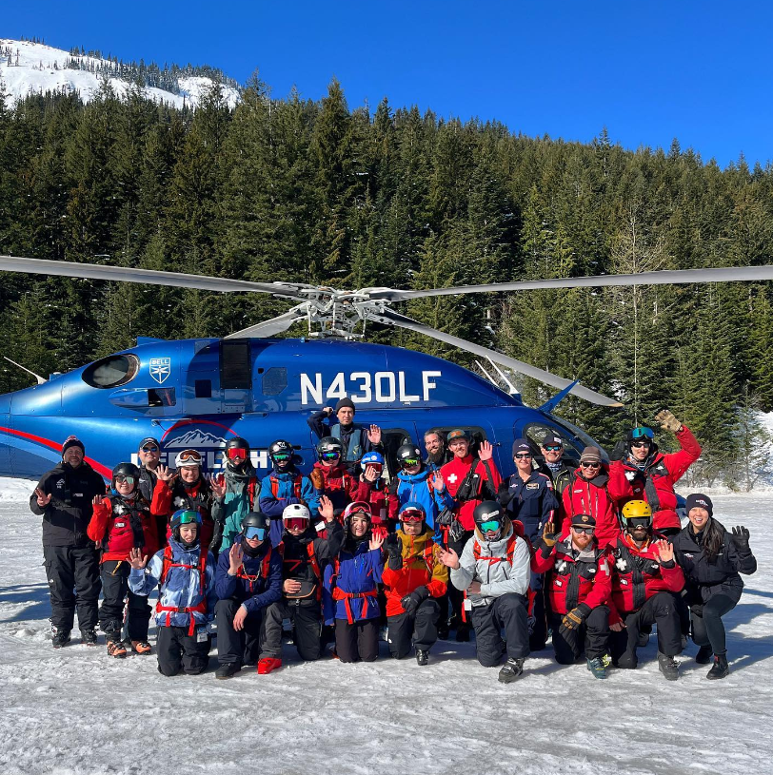

Slide 15
SPY Division Goals
3. Regional Advisors Rollout
Discovery: Who has programs
Strategy: Single/Program/No Program
Execution: Resort Check ins/Advisor Updates
Notes:
Discovery Phase
Which divisional resorts "actually" have a single SPY patroller OR a program (NSP doesn't have current data so we have to gather)
Strategy Phase
Resorts with a single SPY
formalize a manageable path forward for the resort to build the program
Resorts with a SPY program
upload program info to PNWD website, inventory actual number of SPY's in program, regional advisor work with me to support program buildout based on resort resources
Resorts with NO SPY Program
Regional advisor work with resort to understand challenges, then work with me to help develop path forward thats reasonable based on resort resources
Execution Phase
Regional advisors speak to resorts 2-3x in the season & report back on progress at the bimonthly Divisional /Regional SPY advisor call
PNW SKI CLUB COUNCIL - 27 clubs in the PNW! promoting SPY programs

Slide 16
SPY Programs
Day: Patrol Intro (low investment)
Month: (Pilot) Patrol/Career/Ops (medium)
Season: OEC/OET/Mentor (traditional)

Slide 17
SPY Plug & Play
Recruiting
Administration
Programming
Legal & Documentation
Presenting (to patrol/resorts/NSP)
Uniforms
Press
Social Media(retention & recruiting)
Awards
Notes:
RECRUITING
Recruiting strategy suggestions, posters, recruiting goals based on metrics
ADMINISTRATION
Suggested excel workbook set up to track: recruiting venues, interested candidates, paperwork received, SPY participants at resorts....
PROGRAMMING
Spy 1 (16/17 yo): 4-week intensive mountain training
Spy 2 (18+y.o): mentoring program/integration into adult patrol
LEGAL & DOCUMENTATION
Commitment forms
Release forms
youth in sport requirements/step by step
PRESENTING (to patrol/resorts/NSP)
power point explaining the program
UNIFORMS
ready-made for resort: SPY helmet sticker, SPY patch, SPY 30l ski specific backpack
PRESS
tips on how to engage TV, ski clubs
SOCIAL MEDIA (retention & recruiting)
suggestions for building a content photo library, an editorial calendar set up for pre-season recruiting/ during the season posting/ post season "maintaining interest"
AWARDS/DOCUMENTATION
certificate of completion (includes the syllabus from training as documentation)
suggestions on how to track programs for better retention/recruiting/reporting

Slide 18
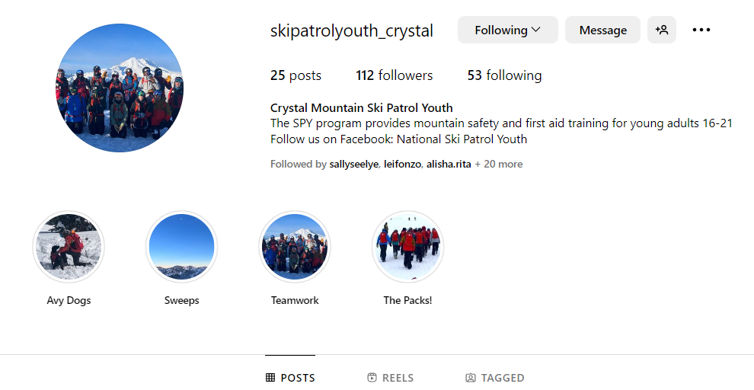
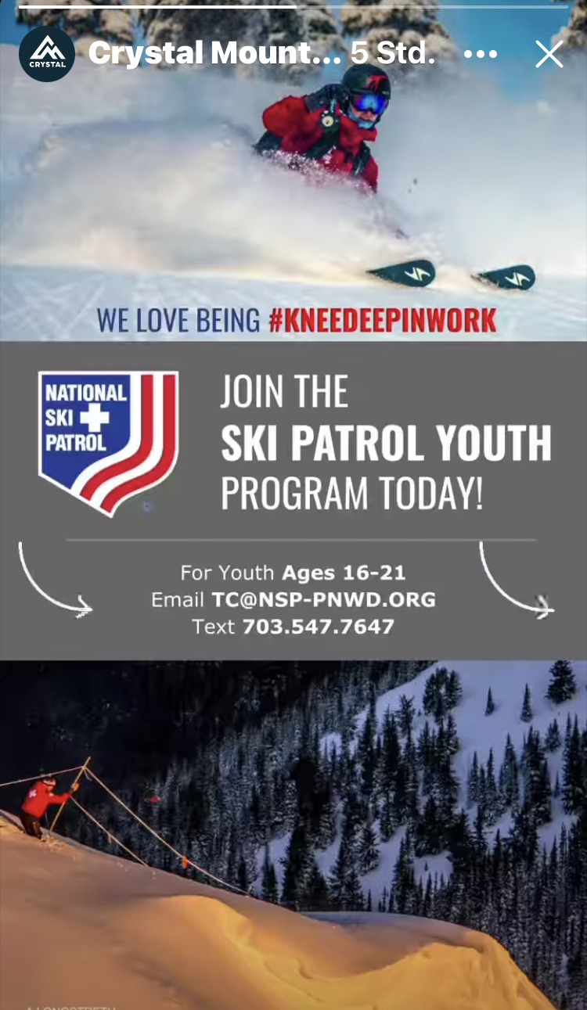
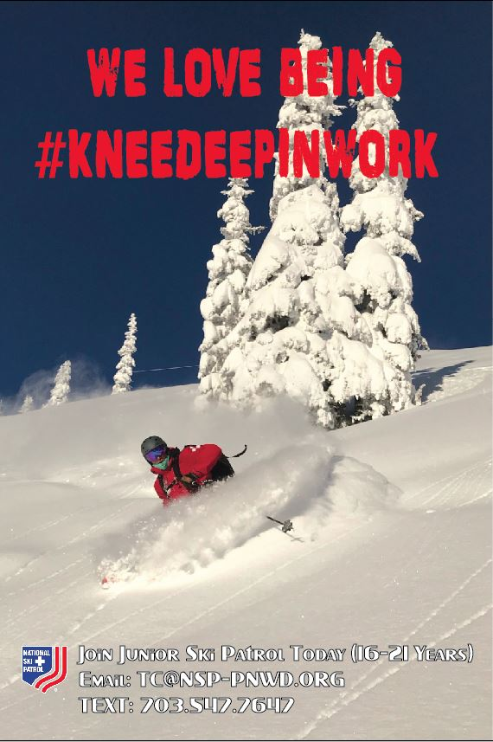

Slide 19
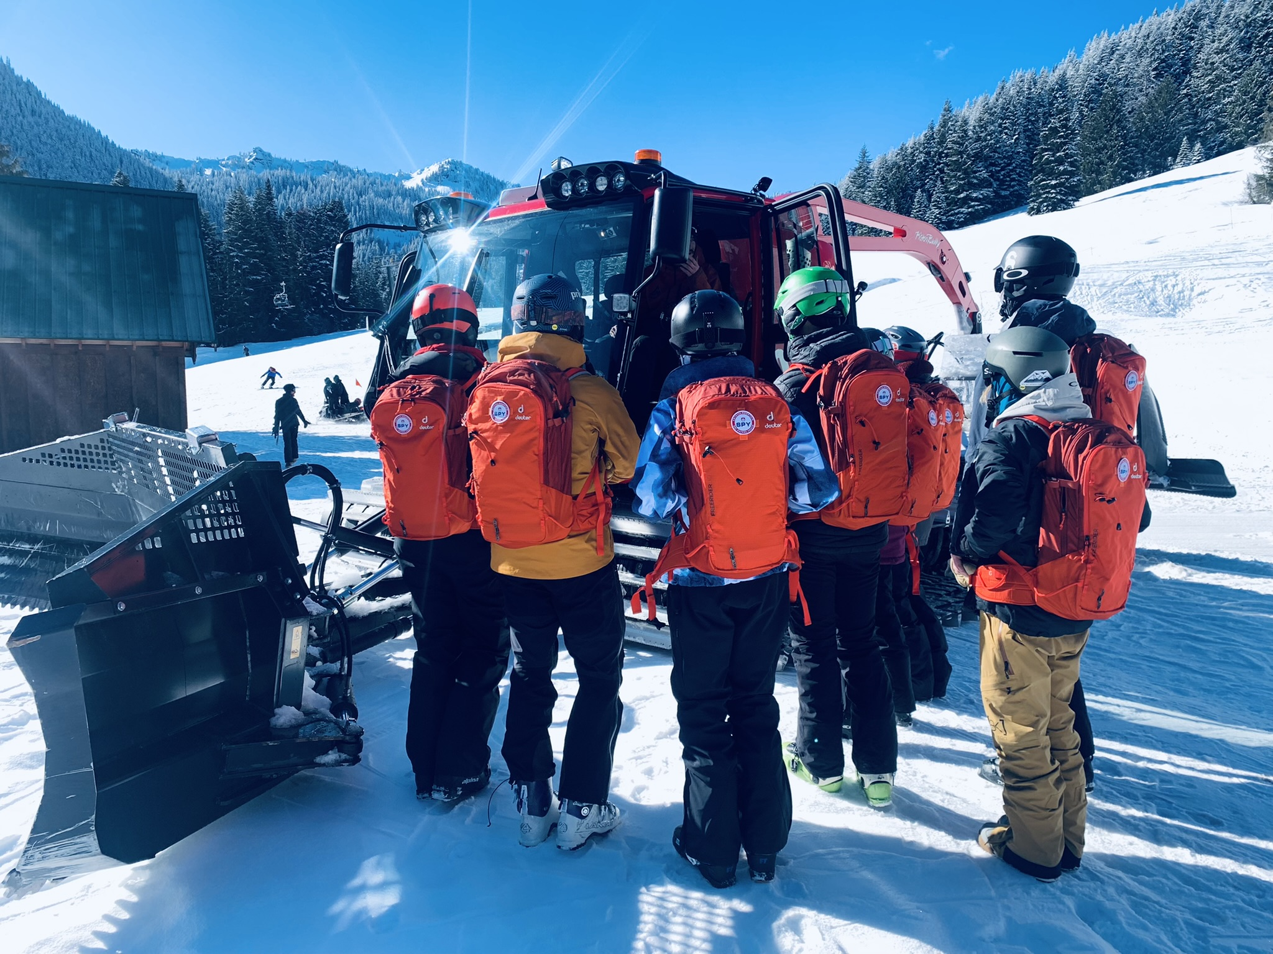
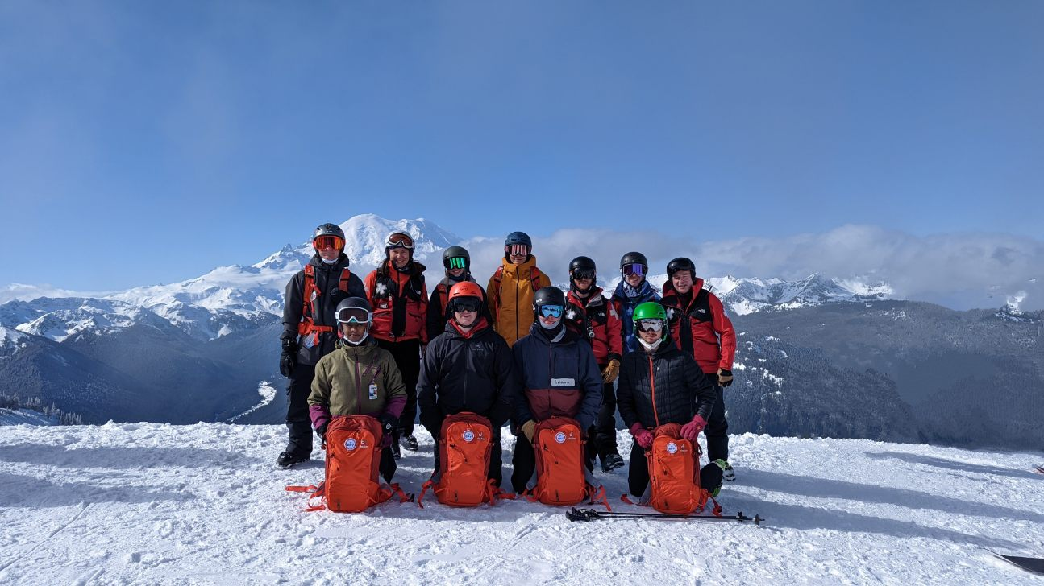
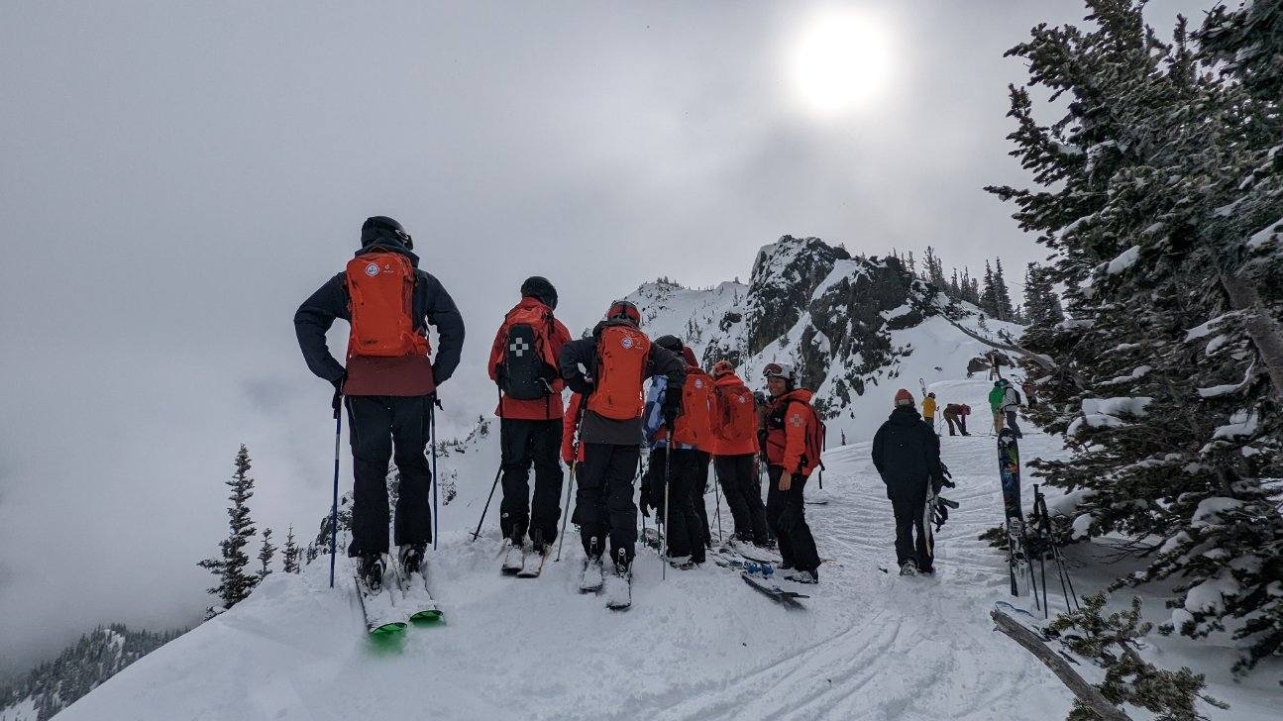

Slide 21
Thank You

Slide 22
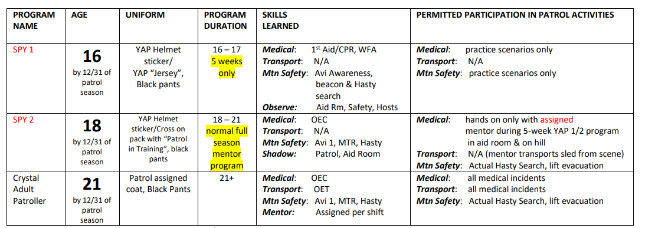
Crystal Mountain Only SPY Format
What do SPYs Learn

Slide 23
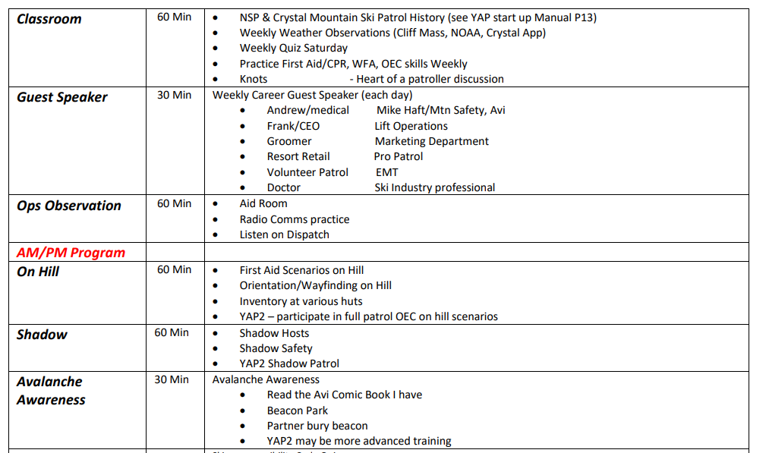
SPY 1 Format
SPY1 Daily Program

