Slide 1
SafetyCulture4All
Patroller Wellness
Notes:
Video from Pete Alfort,
WELCOME
Have you seen this video?

Slide 2
Notes:
CLICK ON RED YOU TUBE BUTTON IF & WHEN IT SHOWS UP IN THE MIDDLE!!!!!
Mt Baker Tree Well Accident YOUTUBE
Note swearing
USE to 4minutes…. ? After….
https://youtu.be/m5ME9Swo0_8?si=2HMLJyIi1vnawSjg
https://youtu.be/m5ME9Swo0_8?si=LmGI5G366IH9wldf&t=7
EMBEDED FILE:
<iframe width="560" height="315" src="https://www.youtube.com/embed/m5ME9Swo0_8?si=LmGI5G366IH9wldf" title="YouTube video player" frameborder="0" allow="accelerometer; autoplay; clipboard-write; encrypted-media; gyroscope; picture-in-picture; web-share" allowfullscreen></iframe>

Slide 3
WHAT’S YOUR IMPRESSION AFTER SEEING THAT ?
WHAT WOULD YOU DO AFTER THIS?
END OF SHIFT - EVENING?
THE NEXT DAY?
Notes:
FOCUS on Patrollers Response & DAY TO DAY
HOW DID THE VIDEO MAKE YOU FEEL &
HOW HAVE YOU DEALT with things BEFORE
HAS it been effective?
How would you help a friend dealing with that?

Slide 4
What Patroller Wellness & Stress awareness IS NOT..
Not CISD/CISM
Not Single Isolated Event
Not Personal Counseling
Not just having local/county resources to call
Notes:
BUILDING a FOUNDATION
Daily, Weekly, Monthly
Become the norm vs the exception
30sec morning /evening meeting, but DO IT

Slide 5
What is Patroller Wellness & Stress Awareness?
Foundation - Daily & Beyond
Awareness of Stress Injuries
Ways to Manage
Tools for the Toolbox ……
Notes:
Bring together Physical Injury and Psychological Injury
UNPACK a Backpack
ETC,what term(s) can you think of?

Slide 6
What is Patroller Wellness & Stress Awareness?
Education/Training
Resources for All
Access for All
Notes:
PNWD SC4A WEBSITE,
SoCal and Easterns Website
NSP WEBSITE
RESPONDER ALLIANCE
TRAUMA STEWARDSHIP
& MANY OTHERS- share list

Slide 7
REACTIVE - OLD WAY
PROACTIVE - NEW WAY
Only Critical Isolated Events
Wait for it to Happen
Unprepared / Delay Resources
Handling by Select Few
Lose members
Build Foundation
Learn & Understand
Practice Daily / Weekley
All Involved / Supported
Evolve & Expand
Notes:
Comparison by LINE from OLD to NEW

Slide 8
<iframe title="vimeo-player" src="https://player.vimeo.com/video/557606322?h=1750380a22" width="640" height="360" frameborder="0" allowfullscreen></iframe>
Notes:
https://vimeo.com/557606322
https://vimeo.com/557606322
Venmo, Eldora Patrol Resiliency Psychological First Aid.mp4
75-90seconds are KEY,
can play longer…
NOTE: MAY NEED TO EMBEDE OR USE SEPARATE VIDEO FILE LOADED…….
Check out “Eldora Patrol Resiliency Psychological First Aid.mp4” from Responder Alliance on Vimeo. The video is available for your viewing pleasure at https://vimeo.com/557606322 If you like this video, make sure you share it, too! Vimeo is filled with lots of amazing videos. See more at https://vimeo.com.
EMBEDED FILE WEBSITE
<iframe title="vimeo-player" src="https://player.vimeo.com/video/557606322?h=1750380a22" width="640" height="360" frameborder="0" allowfullscreen></iframe>

Slide 9
SupportED by the National board
“National Ski Patrol is committed to creating and supporting a culture of wellness, safety, and resilience for all our members and those whom we serve. Honoring NSP core values, we will provide our community with the awareness, leadership, guidance, education, and resources needed to help ensure their emotional and mental wellbeing.”
ALL PATROLLERS
Notes:
6/2023 BOD Support

Slide 10
Notes:
FOCUS YOUR ATTENTION ON THE WALL, Near the DOORs,
HANDOUTS AND YOUR POST A NOTES.
LETS BRAINSTORM,
HOW AT YOUR AREA
HOW GLOBALLY refer to RA Stress Continum example
Many ways to give examples

Slide 11
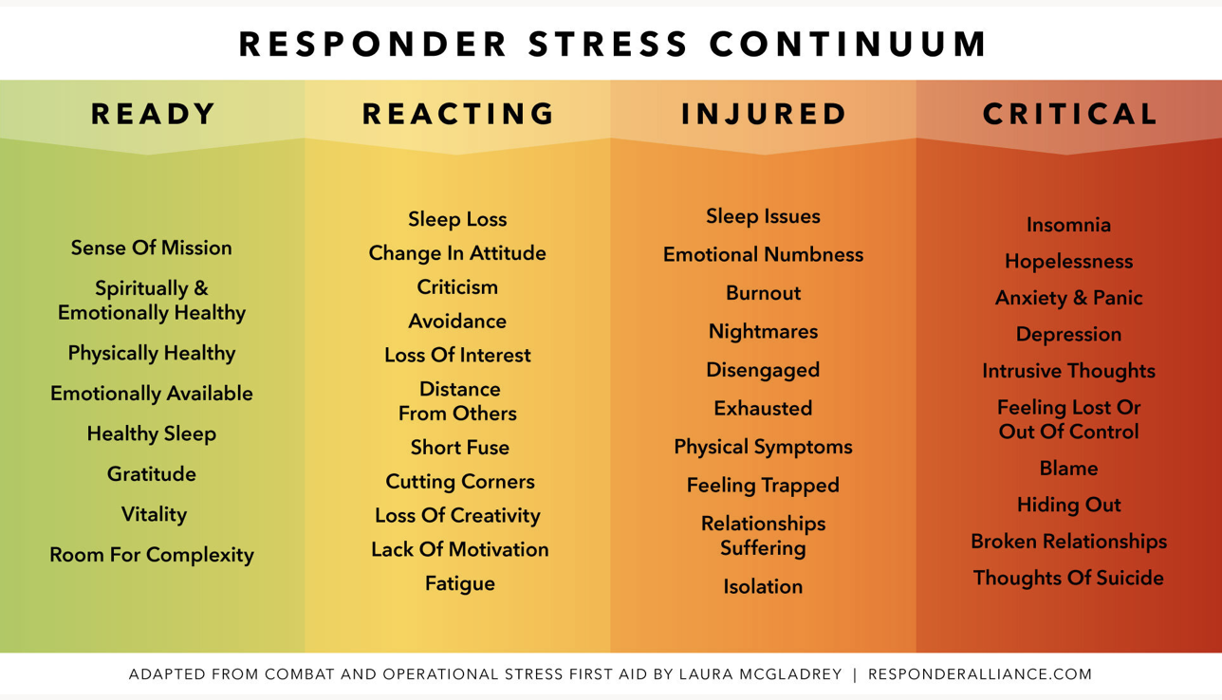
Notes:
SUPPORTED BY RESPONDER ALLIANCE, ABLE TO USE.
WHAT THOUGHTS DO YOU HAVE, THINKING OF YOUR PATROL?
Make your own with the cards at the tables…..

Slide 12
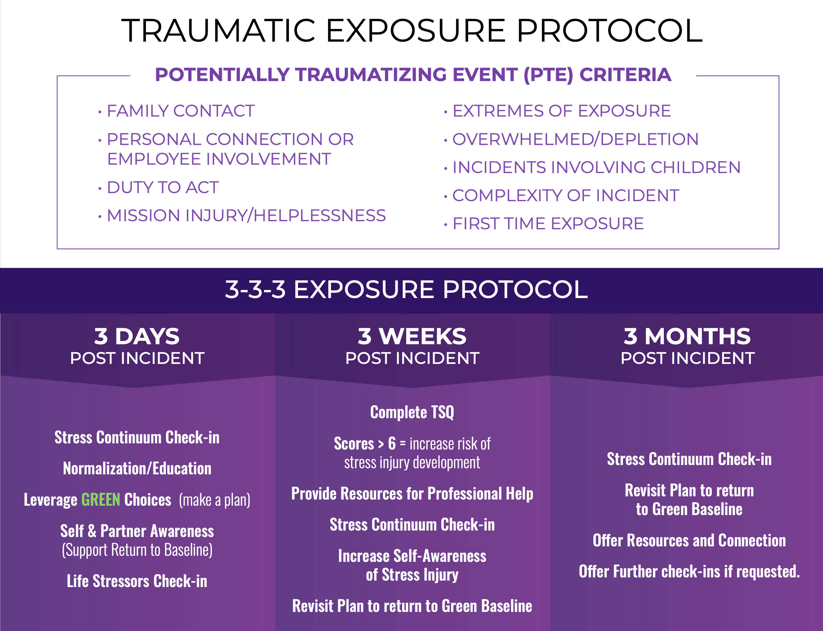
Notes:
LETS TALK FOLLOW THRU, FOLLOW UP
WHY??
WHAT BARRIERS FOR YOUR AREA?
HOW DO WE OVERCOME THESE?
Whatever number YOU Choosse to use but know the following is true
Days are commonly done
Weeks not as common
Months rarely done and harder on most individuals, feel most forgotten
3-3-3 or 3-4-2 or??

Slide 13
Notes:
OPTIONAL if lots of beginners, hold off
Talk about Contributing factors ?

Slide 14
Notes:
Handout

Slide 15
Notes:
Weekly check in
Possible signs / symptoms of stress

Slide 16
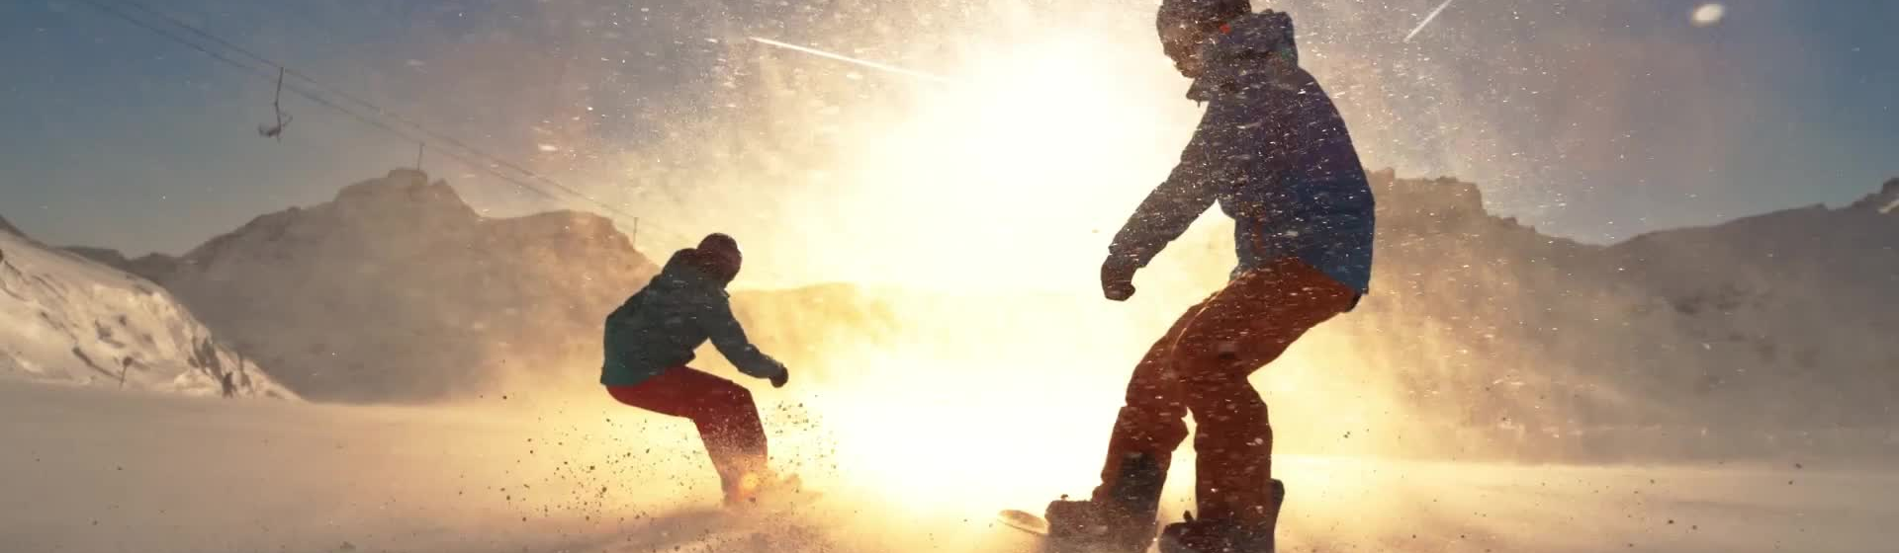
Momentum
NSP National Task Force / Support Statement
Other Patrols / Divisions Starting
Learn from one another
Start Early – Candidates
Reach Out – Potential Misses
Notes:
NSP BOD supported,
FarWest Region/SoCal.
Eastern Div,
Central just starting.
Encourage Starting Early – but FREQUENTLY
KNOW that Candidates… are asking for this program, information

Slide 17
HANDOUTS
Notes:
PNWD RESOURCE
QR STARTS,
CLICK – SCAN PHONE,
PULLS UP WEBSITE,
CLICK AGAIN - REFER TO HANDOUTS THEY GOT TODAY

Slide 18
How DO I / WE begin….
PNWD SC4A Monthly Workshops
PNWD Website Tools / Resources
Champions for patrols & region
Share & Network
Give it Time

Slide 19
PIC: Larry Davis, Santiam Pass Ski Patrol
Notes:
ANDY & CARL TESTIMONALS

Slide 20
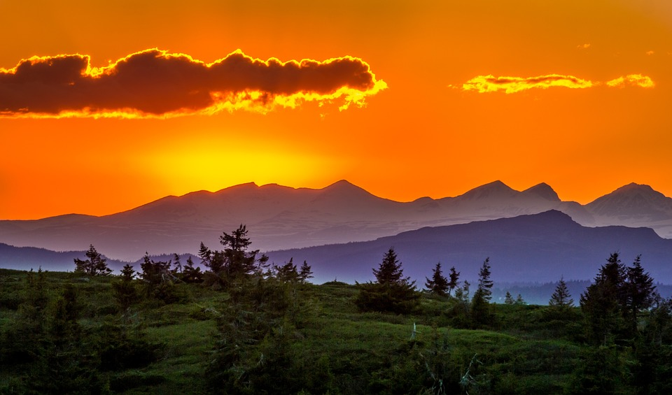
Notes:
OFFER AUDIENCE Patroller TESTIMONALS.
WHAT DO YOU HAVE, DONE, AT YOUR AREA?
WHAT WOULD YOU LIKE TO SEE DONE?
Have a guest secured in case no one speaks up
BUT AVOID lots of SINGLE INCIDENT IF POSSIBLE- CISD

Slide 21
Notes:
ON YOUR WAY OUT, PUT YOUR IDEAS ON THE RESPECTIVE COLOR POSTER NOTE - ON WALL

Slide 22
SafetyCulture4All
Patroller Wellness
Monthly Workshop
3rd TUESDAY
6:30-8pm by Zoom
Notes:
BEFORE YOU GO REMINDERS
BREAKOUT SESSION,
JOIN US ON SafetyCulture4All Workshops.
PACKET RESOURCES
POST YOUR COLORS

Slide 23
Notes:
What terms concepts come to mind for you and your patrol

Slide 24
What Do We Do Now?
WEBSITE Tools / Resources
Other Tools / Resources?
Who’s Interested, Team
Share & Network
Give it Time

