Slide 1
PSYCHOLOGICAL FIRST AID (PFA)
2021 PNWD CONVENTION
KACY CARLSON
MT. ASHLAND SKI AREA - PATROL DIRECTOR
PNWD CERTIFIED PROGRAM - SUPERVISOR
ASSOCIATION OF PROFESSIONAL PATROLLERS (APP) BOARD - CRITERIA COORDINATOR
RESPONDER ALLIANCE - AMBASSADOR and SKI PATROL TASK FORCE MEMBER

Slide 2
PRESENTATION GROUND RULES
This is an interactive conversation.
Ask questions at any time.
If I don't have the answer, I will find it and get it to you.

Slide 3
MY BACKGROUND
Born and raised in Juneau, AK.
Baccalaureate degree in geology - University of Oregon.
Masters in Arts of Teaching - Southern Oregon University.
Around 2018 I earned my NSP Certified # 799 and in 2019 I earned my Association of Professional Patrollers (APP) Certified # 625.
OEC and OET instructor and IT.

Slide 4
WHAT I HOPE YOU WILL LEAVE THIS PRESENTATION WITH
An overview of PFA.
Importance of implementing PFA in your patrol.
Step-by-step PFA implementation guide for your patrol.

Slide 5
WHAT IS PSYCHOLOGICAL FIRST AID (PFA)
PFA is a skills based method of mitigating stress injury formation in both first responders and patients during and immediately after a high-stress event.
Psychological Stress injury – Stress Injury for short - is loosely defined as the effect of an unexpected and overwhelming event experienced by an individual. These effects can occur from a singular event or through cumulative exposure, such as the case of many patrollers. Stress injuries are physical injuries.
THIS IS FOR PATIENTS AND PATROLLERS.

Slide 6
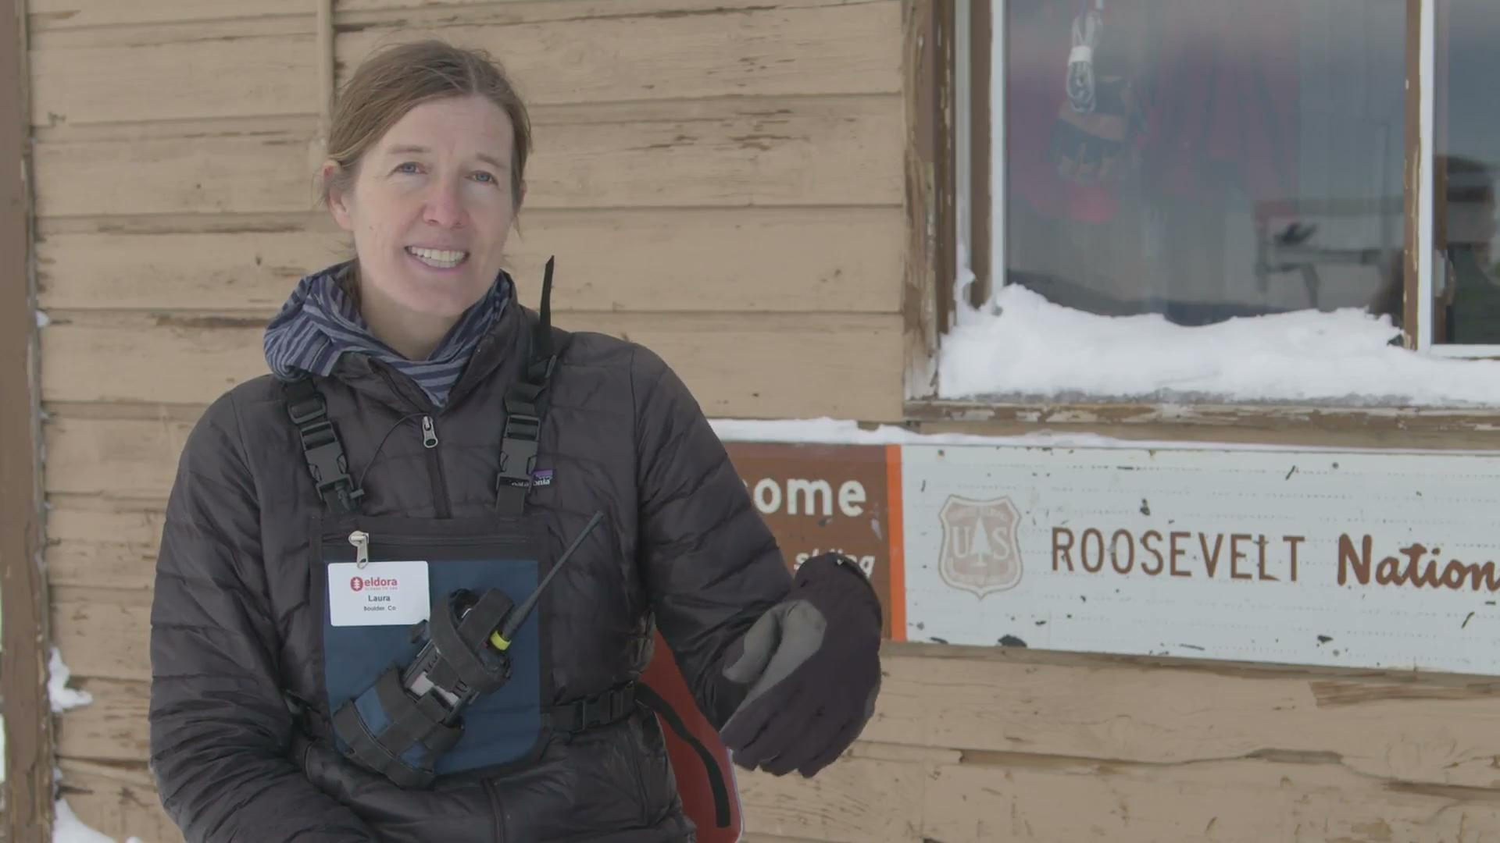
PFA IN ACTION - ELDORA SKI PATROL, CO

Slide 7
WHY DO PNWD PATROLS NEED TO UNDERSTAND AND IMPLEMENT PFA?
“Unprecedented Events” and “Never Have I Ever…”
Seen this many people in the backcountry.
Lived/patrolled during a global pandemic.
Experienced this degree of devastating wildfires.
Stressors outside of patrolling - work and other personal stress.
PFA represents best rescue practice:
We’re already doing it, just do it with science.
Builds trust and awareness for accurate medical diagnosis.
Psychological injuries often far outlast physical injuries and can be permanent.
Decreased physiological load means better patient outcomes.

Slide 8
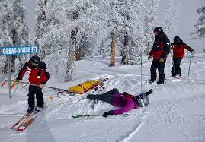
Who is Injured?

Slide 9
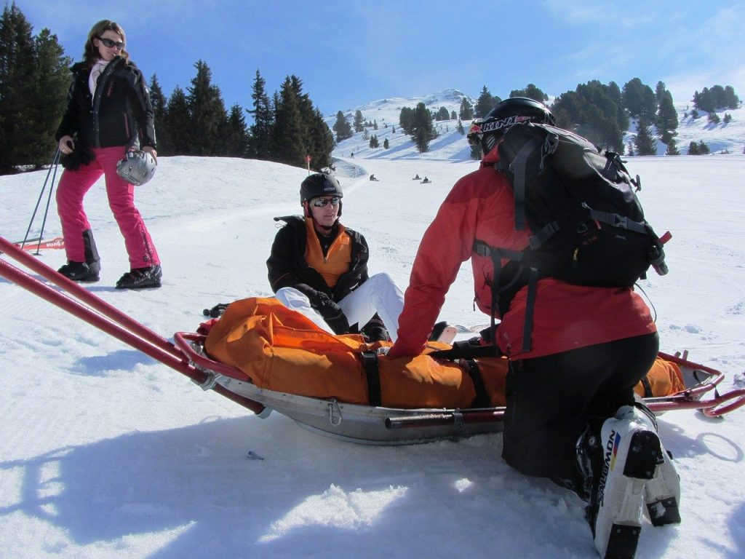
Who is Injured?

Slide 10
LEARNING ABOUT AND IMPLEMENTING PFA CAN HELP PATROLLERS...
Provide better psychological care to patients.
Improve patient outcomes.
Reduce likelihood of patient stress injury.
Provide better psychological care to fellow patrollers.
Prolong the career expectancy of patrollers by aiding in the mitigation of stress injury formation.
Create a cultural that promotes healthy and sustainable self-care routines for individuals and entire patrols.
Notes:
Emphasis on the can of PFA. PFA is not a silver bullet.
Co-workers in leu of responders or patrollers because the mountain community is small and everyone works closely together.
Average patroller career expectancy is five years, both volunteer and professional patrollers (NSP).

Slide 11
RECOGNIZING STRESS INJURY
Stress injury exists on a continuum, commonly referred to as the Stress Continuum Model (SCM) and was originally developed by the United States military to promote psychological health in soldiers.

Slide 12
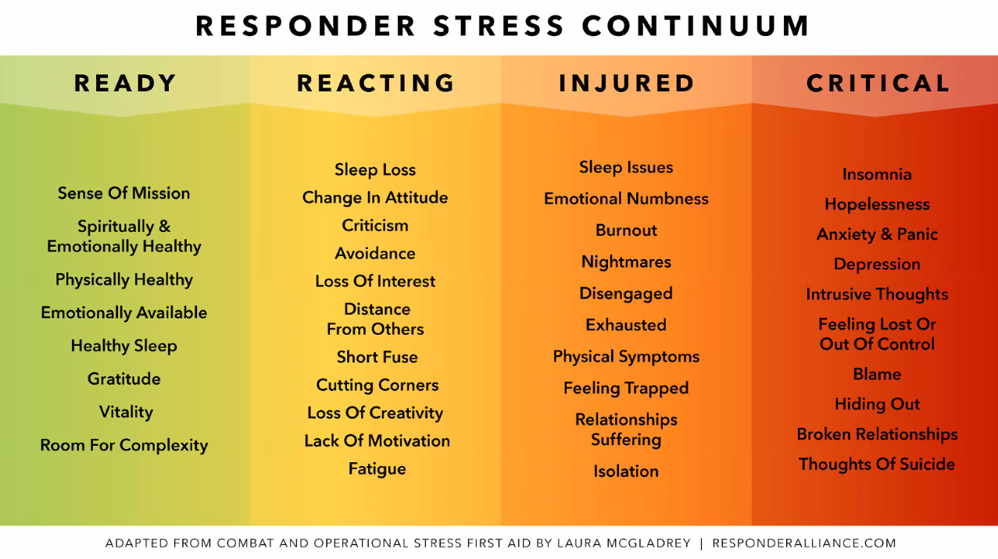
STRESS CONTINUUM MODEL (SCM)
Note: this is a modified SCM specifically for Eldora Ski Patrol, CO. Each patrol should generate specific language to match it’s specific culture.

Slide 13
INTRO TO IMPLEMENTING PFA
PFA has five main components:
Safety – Create an environment (physical and emotional) where the patient/patroller feels safe.
Calm – Use calming language and body positioning in conjunction with grounding techniques to help calm the patient/patroller and reduce hyperarousal.
Connection – Connect with patient/patroller on a personal level by asking about family, friends, or pets. Utilize these resources if present and prudent to aid in connecting with the patient/patroller.
Self-Efficacy/Engage – When appropriate, strategically engage the patient/patroller in their own care or the care of others.
Hope - Remind patient/patroller of facts that support the growth of hope.
These components will be individually described in more detail in conjunction with the responders goals when implementing these PFA components.
Notes:
Safety – Turn/remove Pt. away from scene,
Calm - Hyperarousal (fight or flight) state.
Connection – Allow loved one’s to be present at death.
Self-Efficacy – Hold bandage, pull on rope, lift litter, etc.
Hope – “You survived”, ”You are safe now”, “People will continue to look”.

Slide 14
SAFETY CREATING AN ENVIRONMENT THAT IS PHYSICALLY AND EMOTIONALLY SAFE.
Use language geared toward Safety - “now that you’re safe, “the hard part is over.”
Shield patient/patroller from distressing details - removed distressing sites, sounds, turned down radios.
Offered tangible evidence of survival - warm layer, hot drink, dark chocolate, etc.
Reflected safety of the rescue - “we have lots of people here to help”, “these anchors are bomber”, “this toboggan is the best for this application.”

Slide 15
CALM CALM THE PATIENT/PATROLLER AND REDUCE HYPERAROUSAL.
Use cool, calm, and collected language when interacting with patient and other patrollers.
Give feedback on rescue progrogress or patient improvement.
Practice the use of appropriate facial expressions with other patrollers during times of minimal stress.

Slide 16
CONNECTION CONNECT WITH THE PATIENT/PATROLLER.
Connect with patient through common or shared experiences/likes:
Use their first name and use it often.
Tape name tag on patient.
Ask about their equipment - “how do you like your skis/snowboard?”
Connect with patroller through common or shared experiences/likes:
Use their first name and use it often.
Suggest a healthy and sustainable self-care activity they you both enjoy, then do it together.
Utilize active listening:
Eye-contact
Reflecting statements
Get on their physical level

Slide 17
SELF-EFFICACY / ENGAGEMENT ENGAGE THE INDIVIDUAL IN THEIR OWN CARE OR THE CARE OF OTHERS.
When appropriate ask patient, bystanders and fellow patrollers to assist in the event by:
Holding extra equipment such as medical/rescue gear, patients equipment, etc…
Hold toboggan.
Dig out a planform to stabilize and package on.
Stabilize injury.
Conduct aspects of avalanche burial search.
Etc…
Get creative, engage those around you, even if the task might seem trivial.

Slide 18
HOPE REMIND PATIENT/PATROLLER OF FACTS THAT SUPPORT THE GROWTH OF HOPE.
Rapid transport to advanced medical care facilities.
Remind patroller that winter is temporary.
Not everyday is like this.
You are cared about by your colleagues, friends, and family and will be supported through this experience.
Remind patroller that they are experienced and have tremendous value to the community.

Slide 20
Implantation Example
Mt. Ashland Ski Patrol (MASP), is implementing an anonymous daily PFA check in where patroller selects a colored card corresponding with the SCM color scheme and place the selected card into a closed box.
During the day, a member of the MASP PFA Taskforce, takes an inventory of the box’s cards and catalogs the number of each colored card on a digital spreadsheet. Over time, this spreadsheet serves as a longitudinal tracking of the patrol’s overall psychological health. A patrol’s stress injury vital sign.

Slide 21
Battery Charged vs. Depleted - Stress Injury as a Vital Sign

Slide 22
10 PRINCIPLES OF CRISIS LEADERSHIP
1. Structure is the antidote to chaos.
2. Listen before you speak with intent to understand.
3. Information is the antidote for anxiety.
4. Empowerment is the antidote for feeling overwhelmed and out of control.
5. People trust actions not words.
6. Perceived support is the antidote for isolation.
7. Cohesive groups do better in times of stress and challenge.
8. There’s no such thing as an information vacuum.
9. Transparent, timely and truthful communication.
10. The moment of absolute certainty may never arise.
Guidelines for Frontline Crisis Leadership at JHM during COVID-19 © 2020 Johns Hopkins Medicine. All rights reserved.

Slide 23
ADDITIONAL INFORMATION AND RESOURCES
Responder Alliance
Ski Patrol/Snow Science Community
Survivors of Outdoor Adventure Recovery (S.O.A.R)
Trauma Stewardship Institute
Climbing Grief Fund – American Alpine Club

Slide 24
QUESTIONS?

